Slide 1
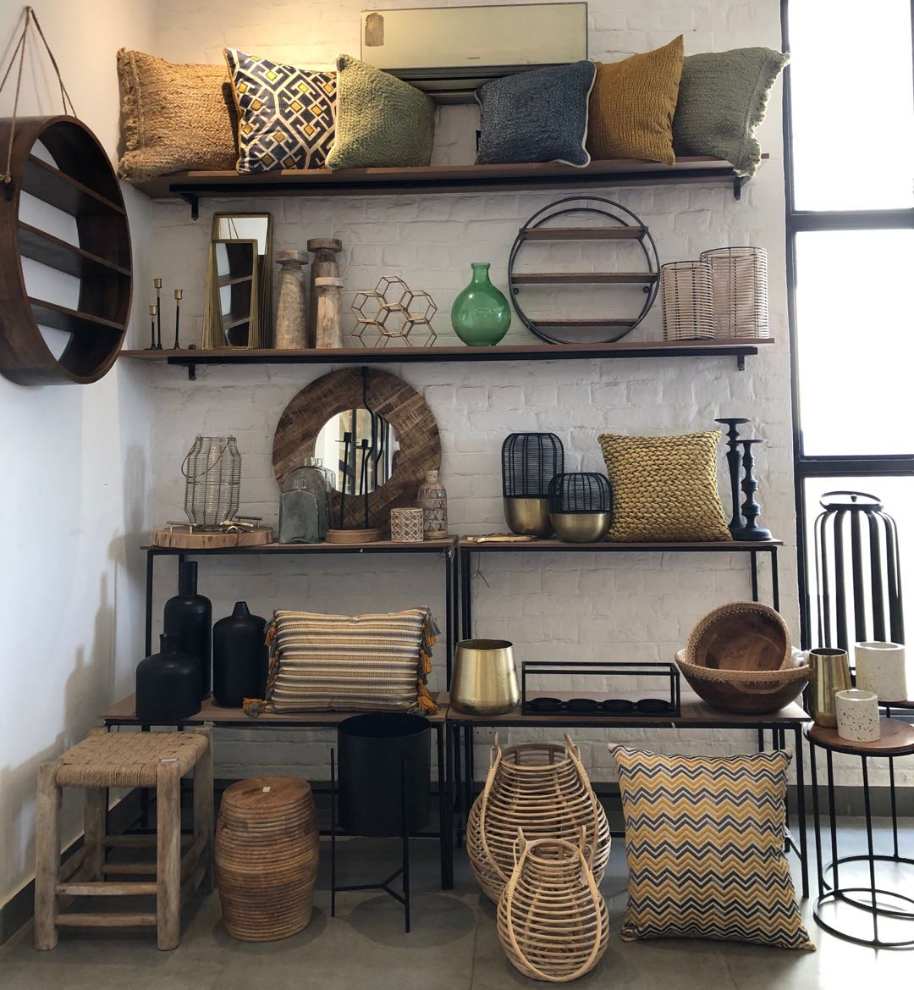
PRESENTATION -1

Slide 2
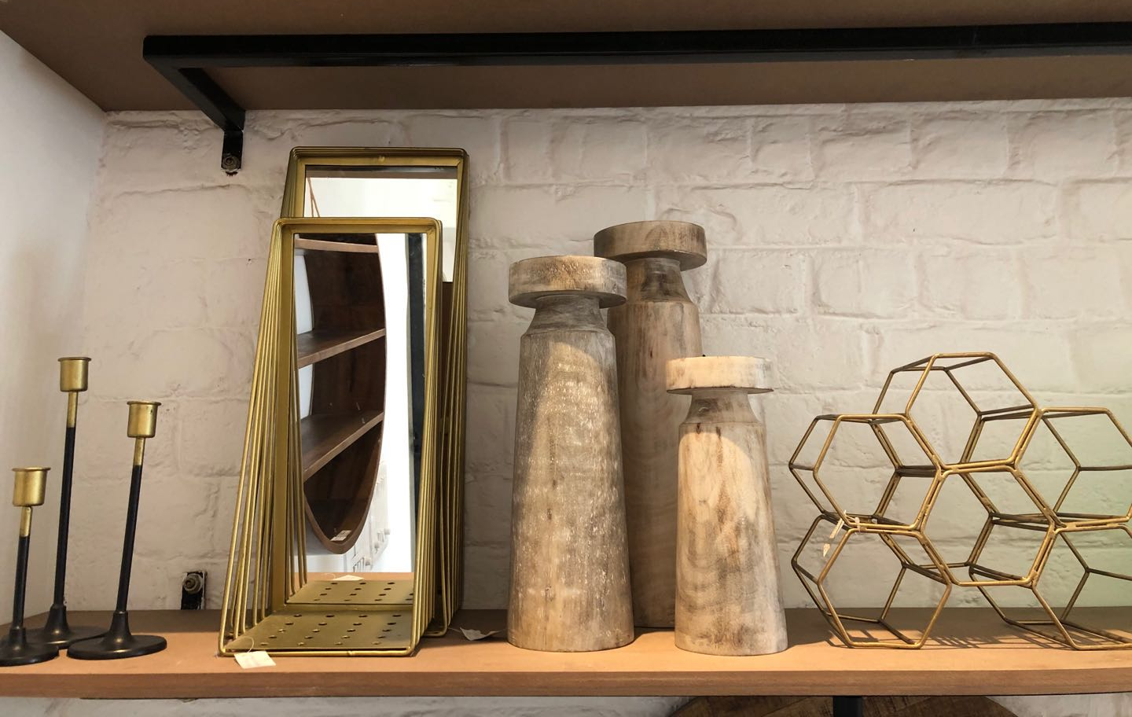
P-1

Slide 3
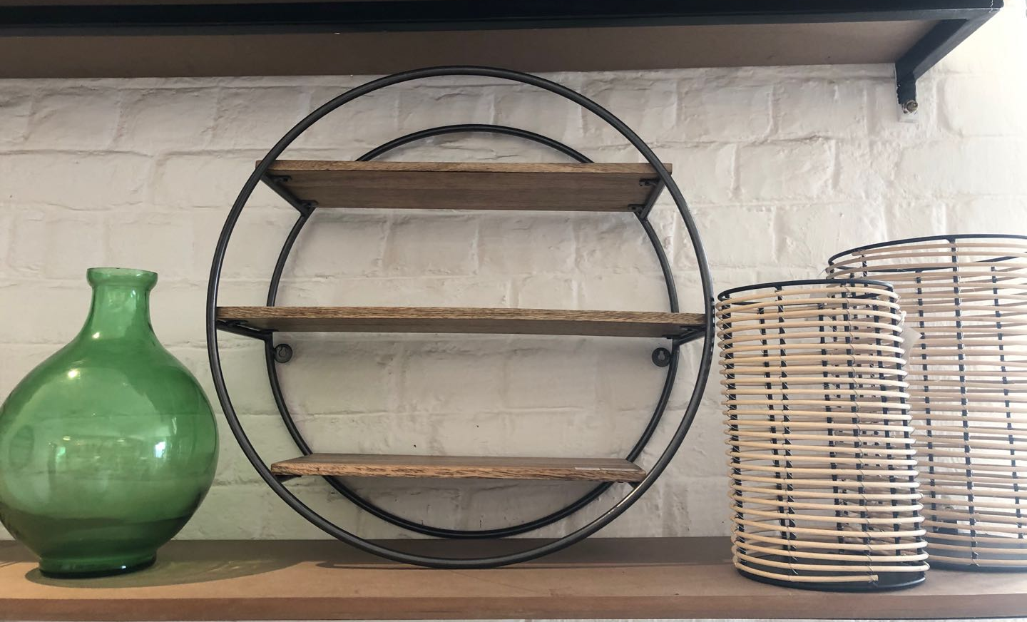
P-2

Slide 4
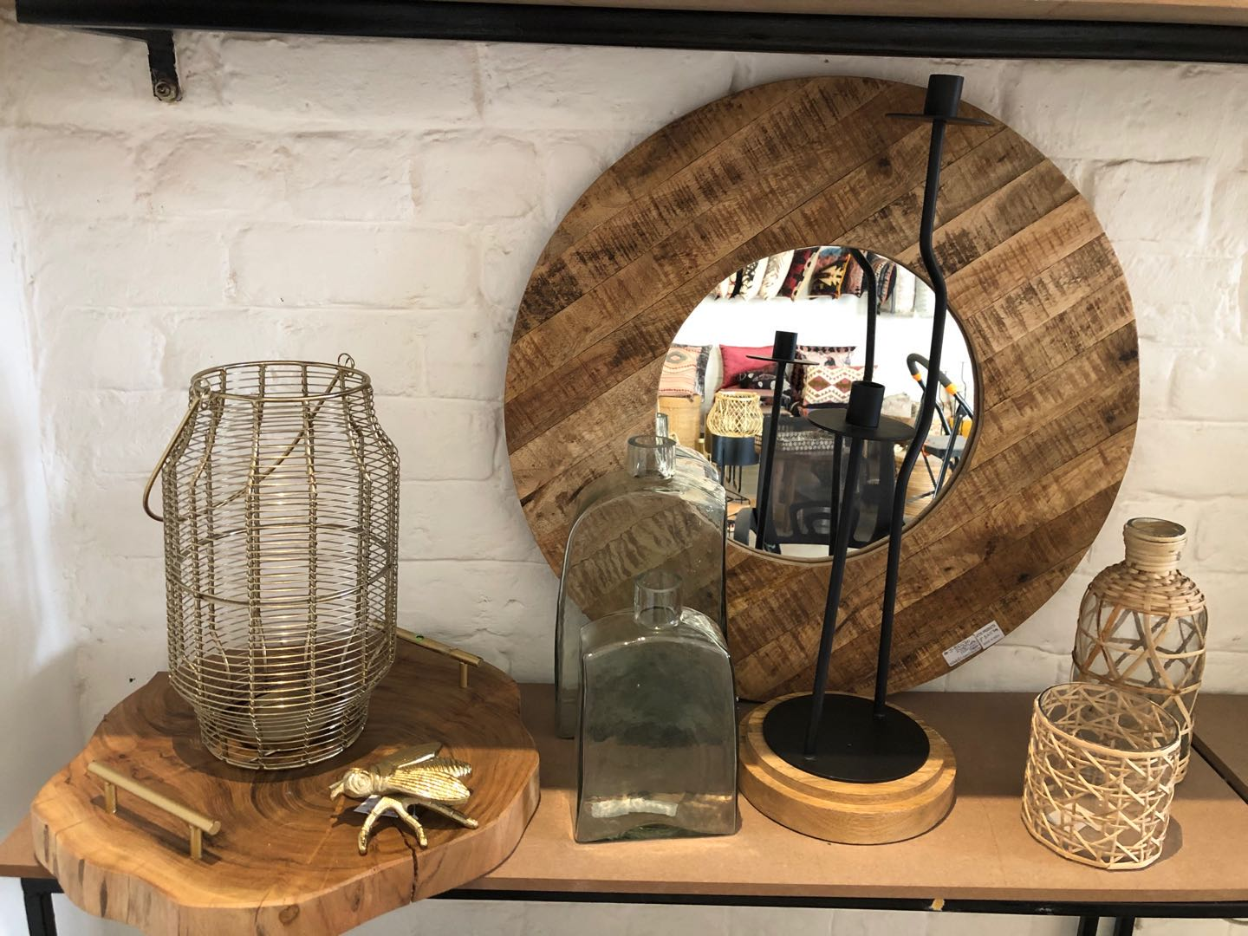
P-3

Slide 5
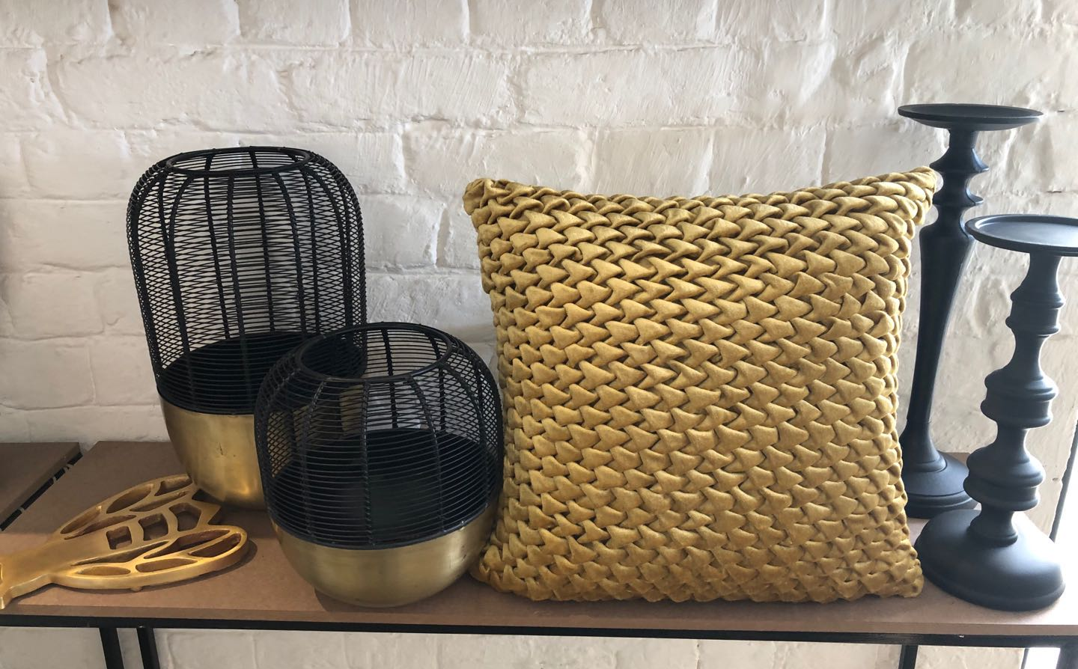
P-4

Slide 6
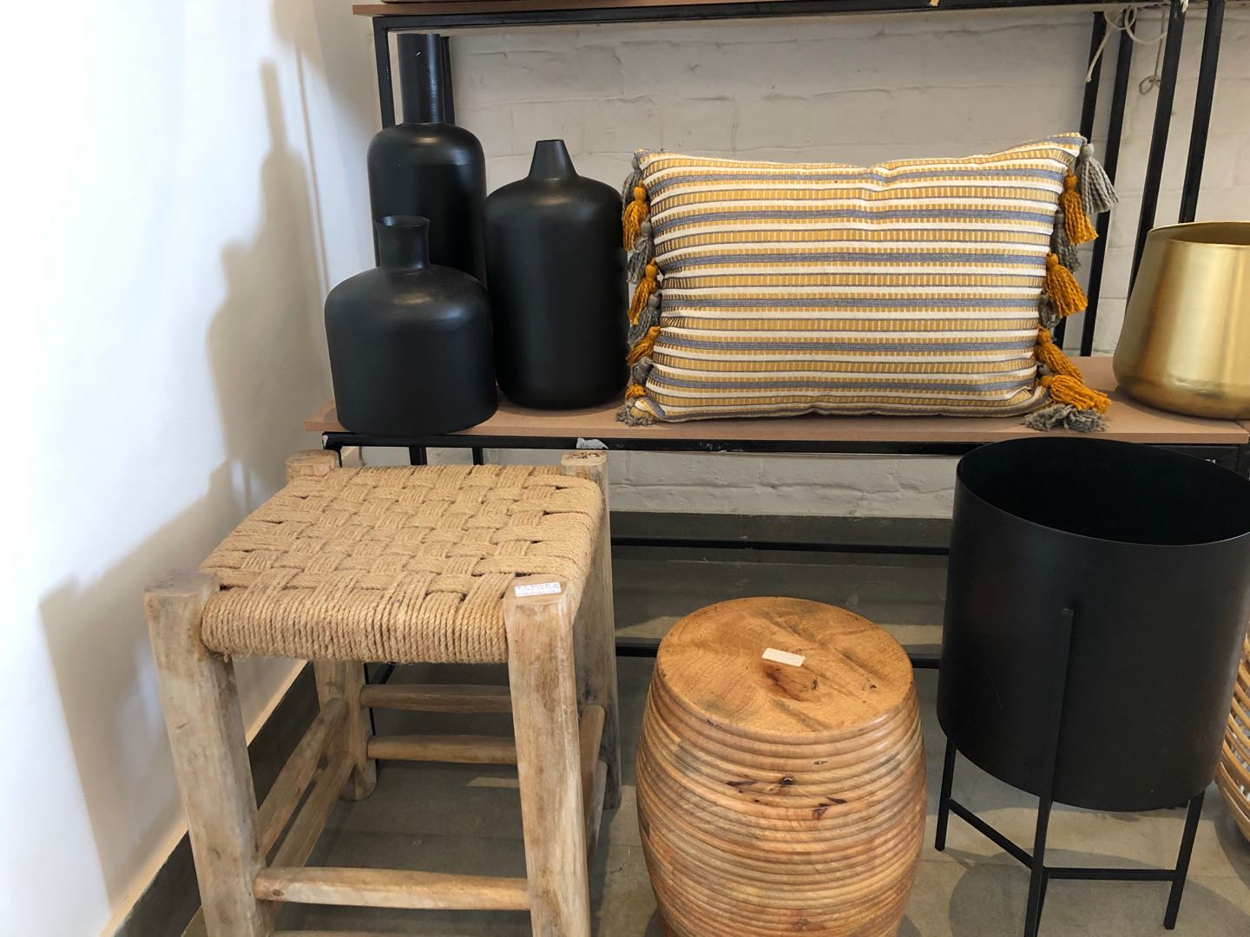
P-5

Slide 7
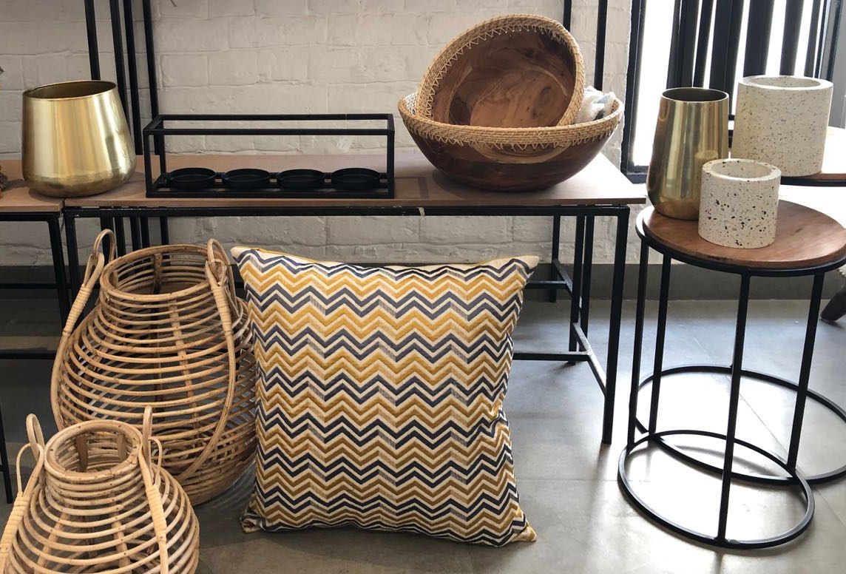
P-6

Slide 8
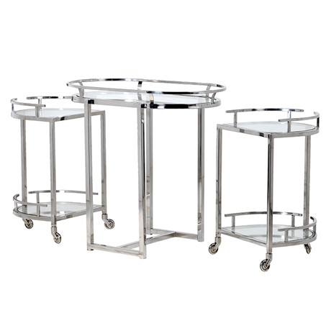
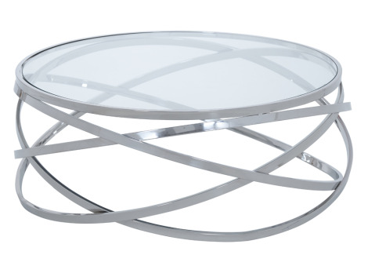
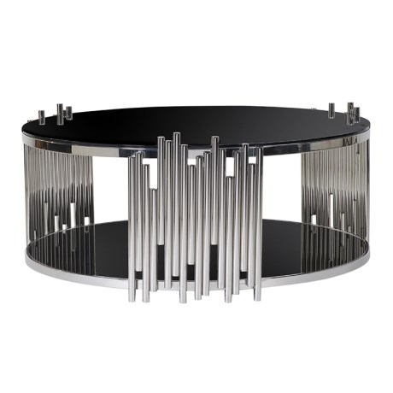
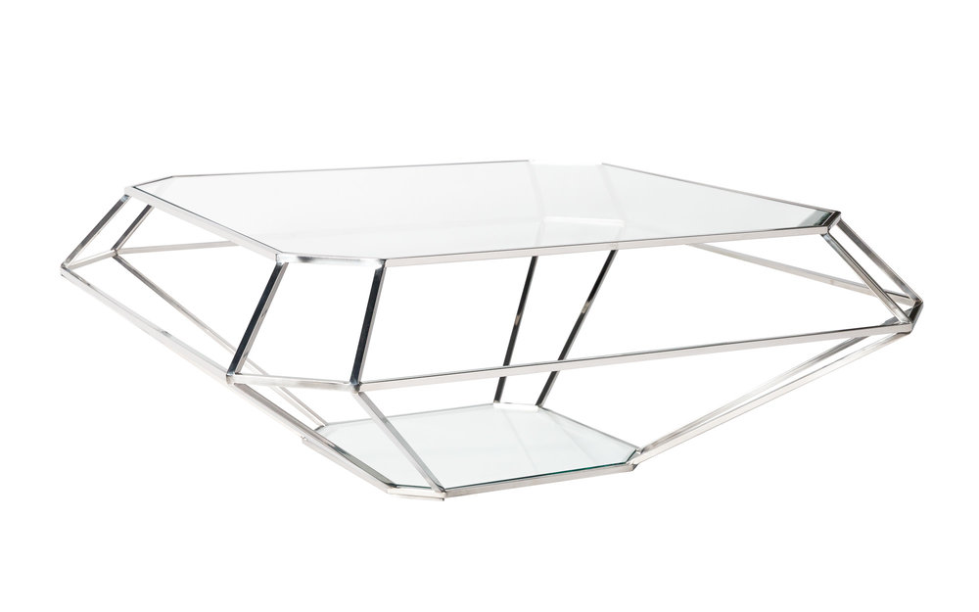
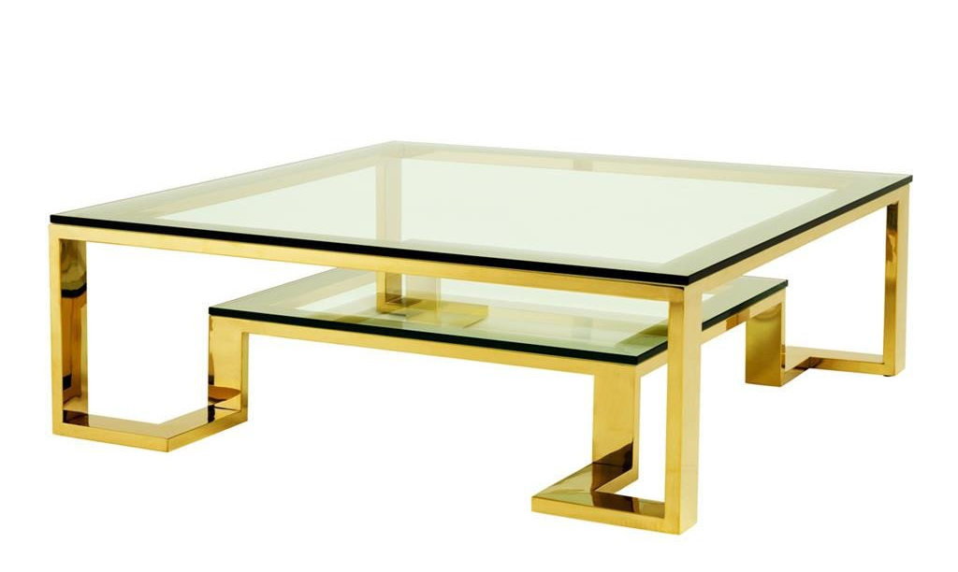
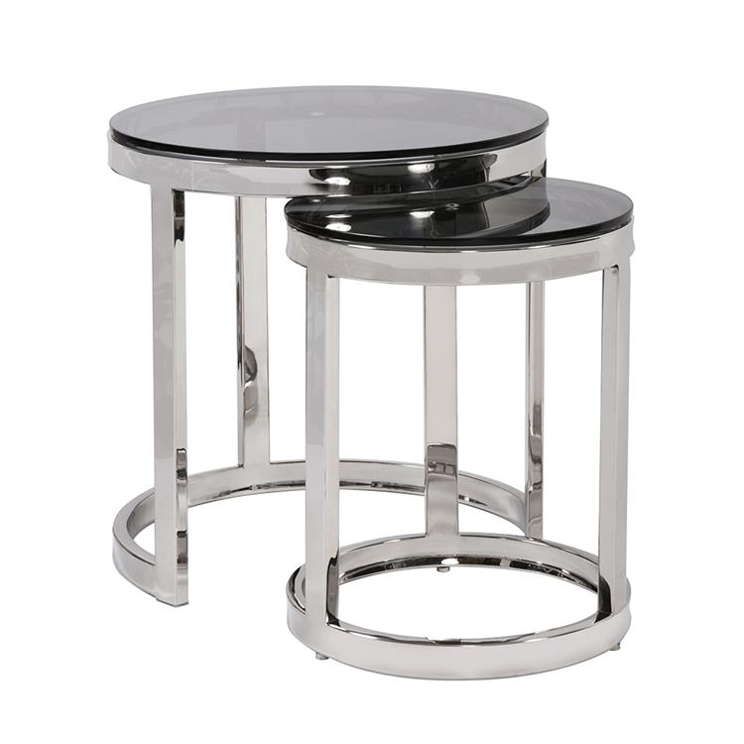
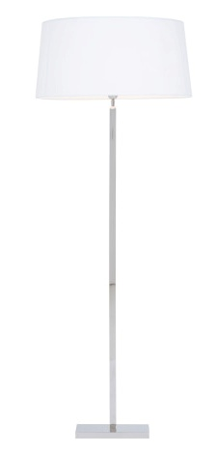
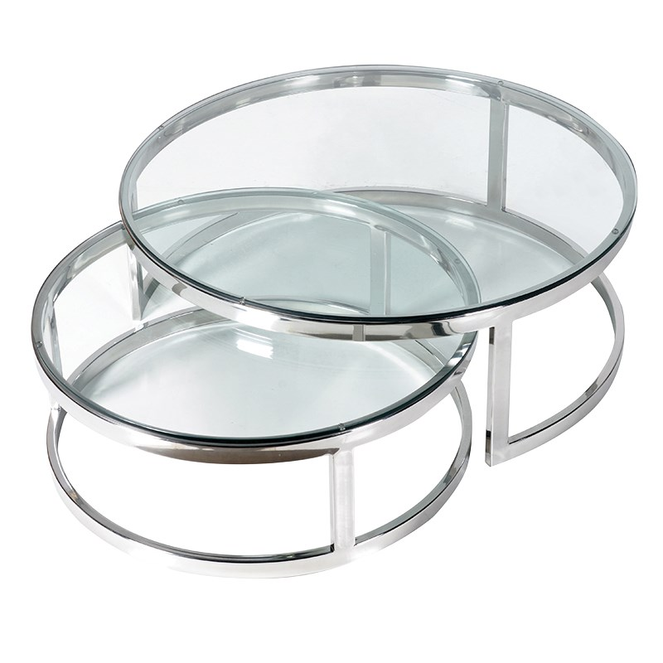
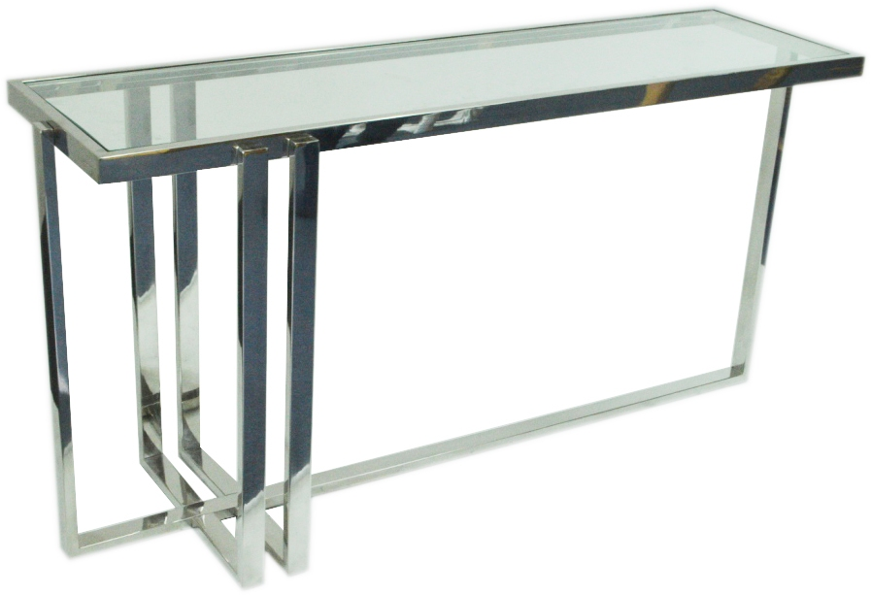
FSTAINLESS STEEL FURNITURE AND OTHER ITEMS

Slide 9
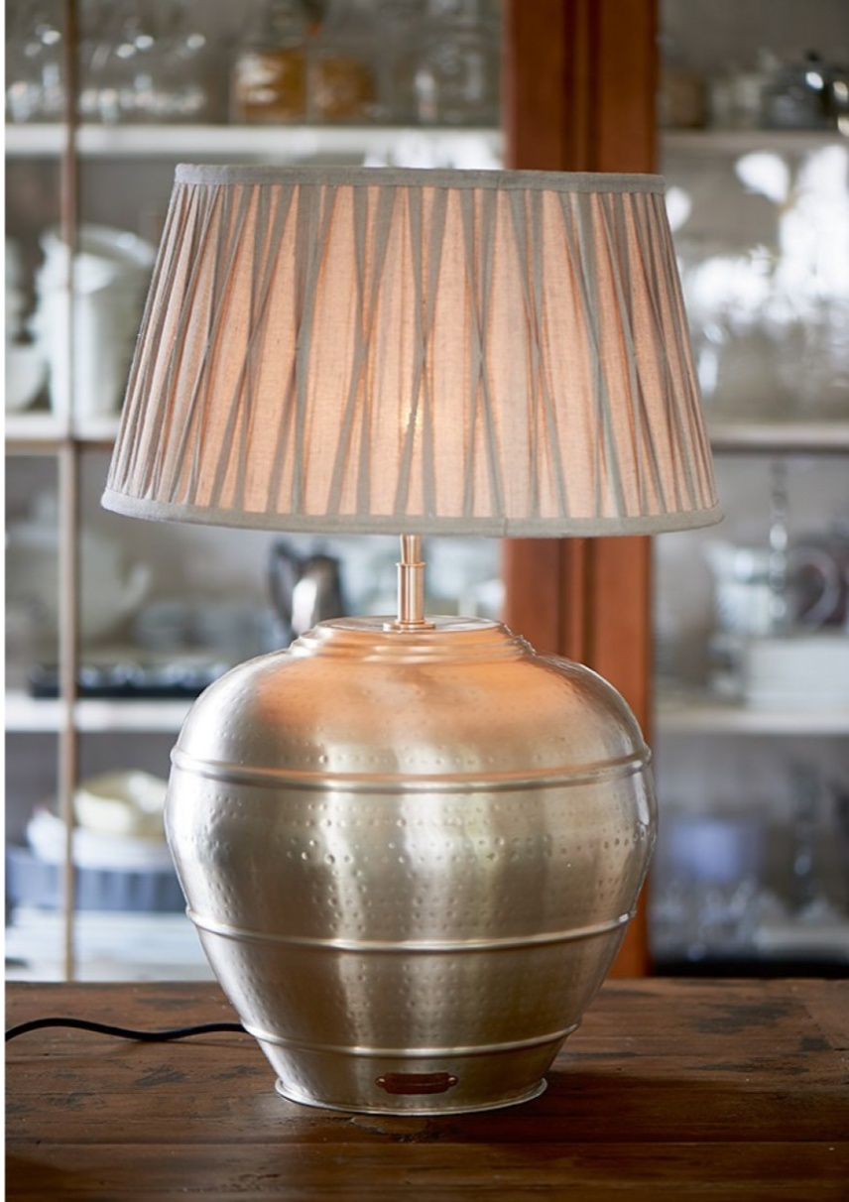
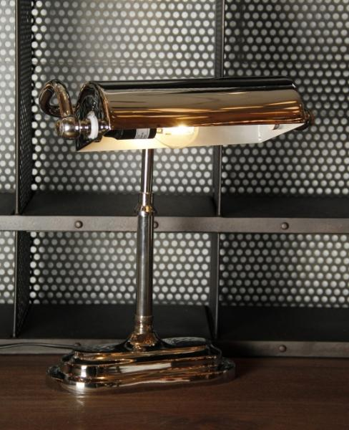
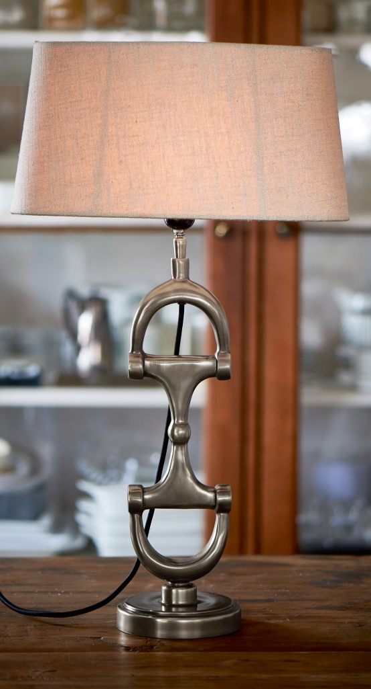
TABLE LAMPS

Slide 10
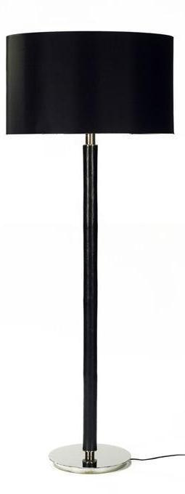
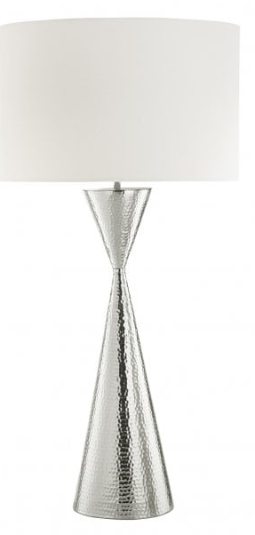
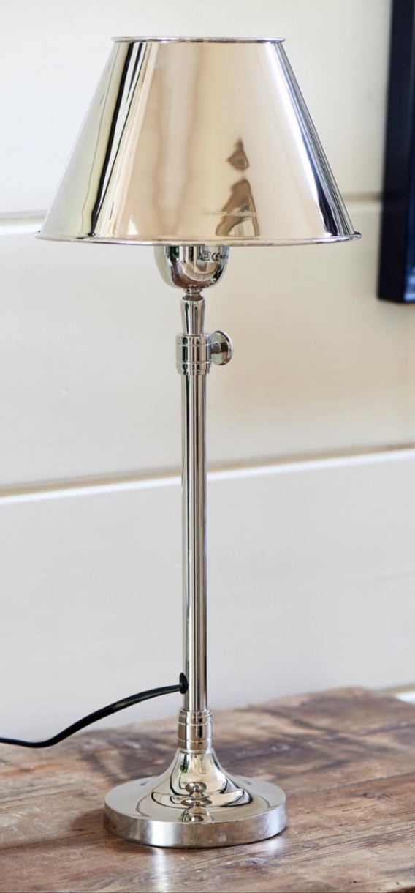
TABLE LAMPS

Slide 11
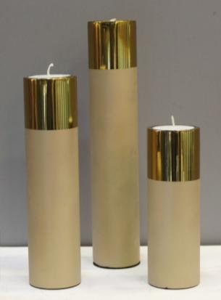
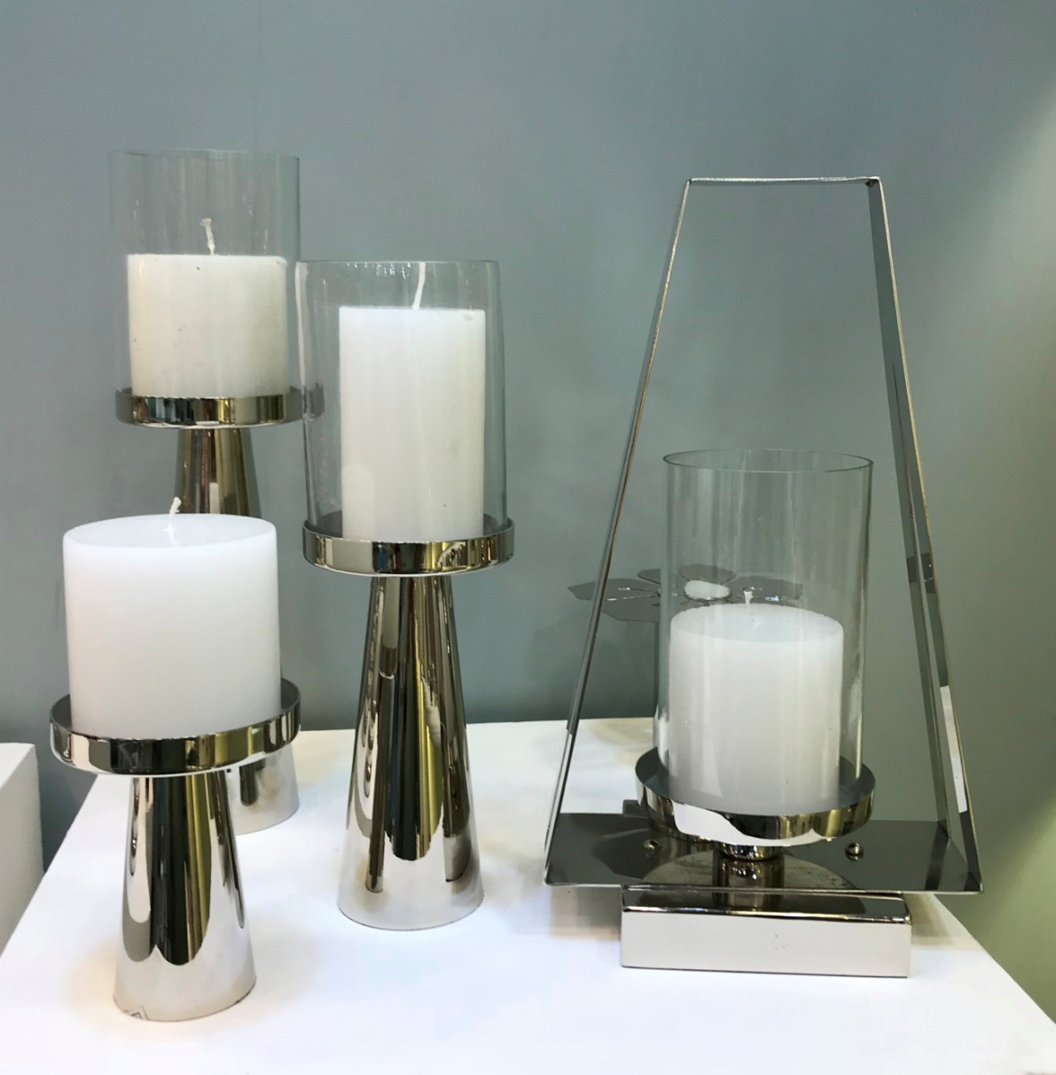
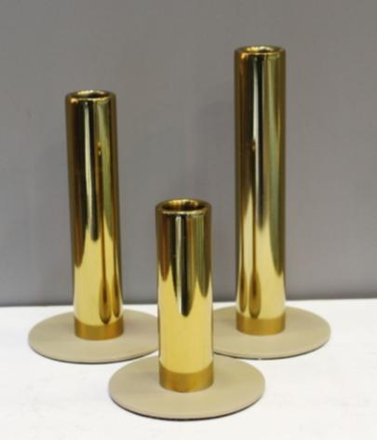
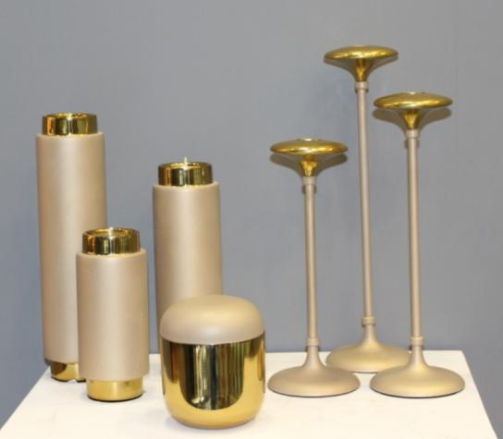
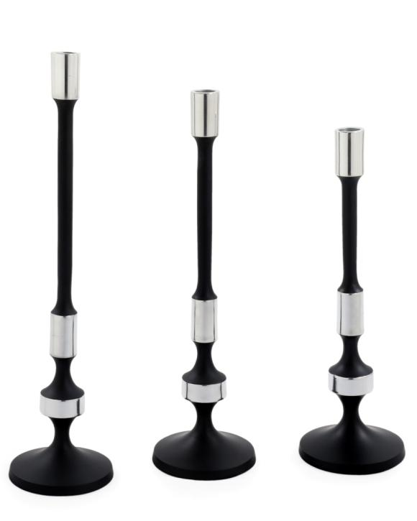
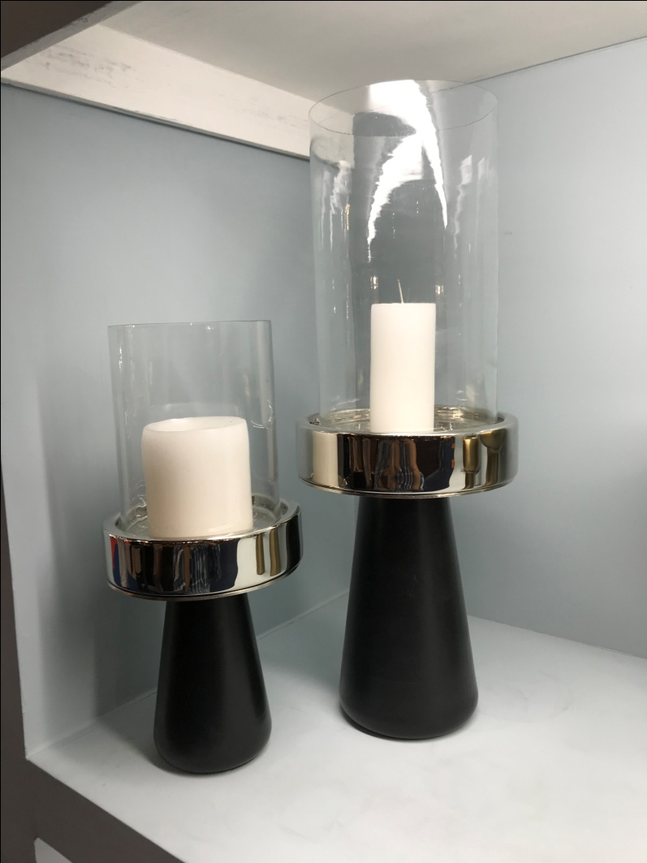
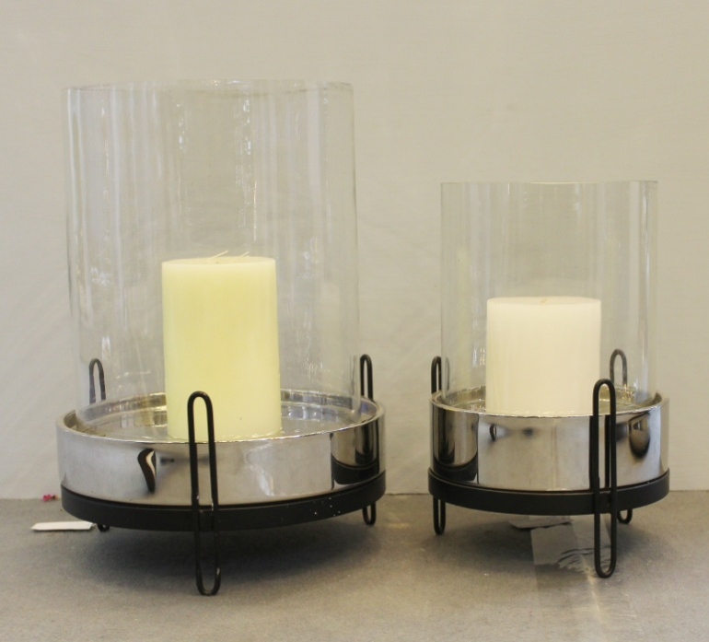
CANDLE STANDS

Slide 12
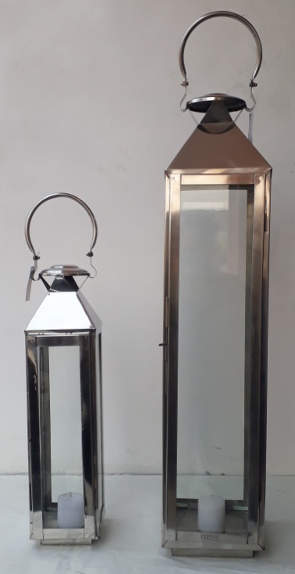
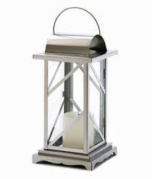
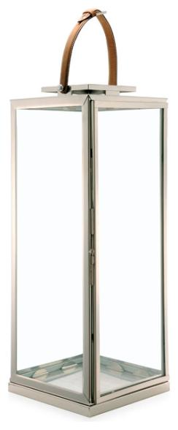
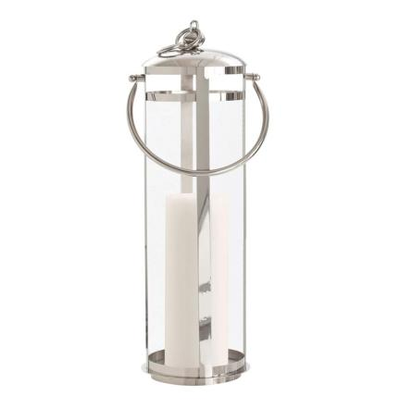
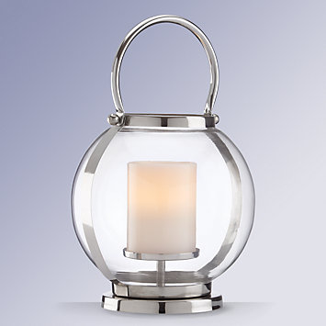
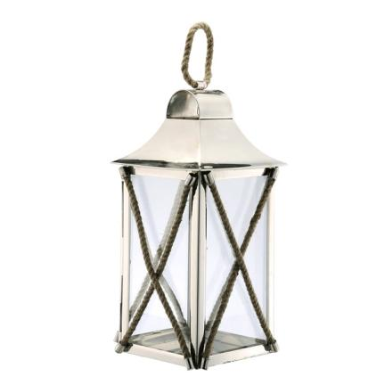
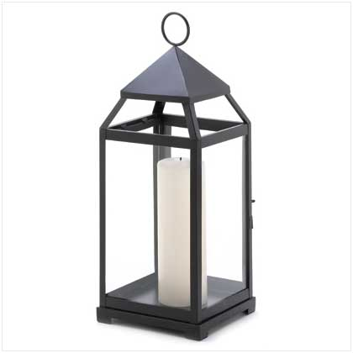
LANTERNS
LT SS 00198
LT SS 00114
LT SS 00192
LT SS 00194 SINGLE
LT SS 00128
LT 00592

Slide 13
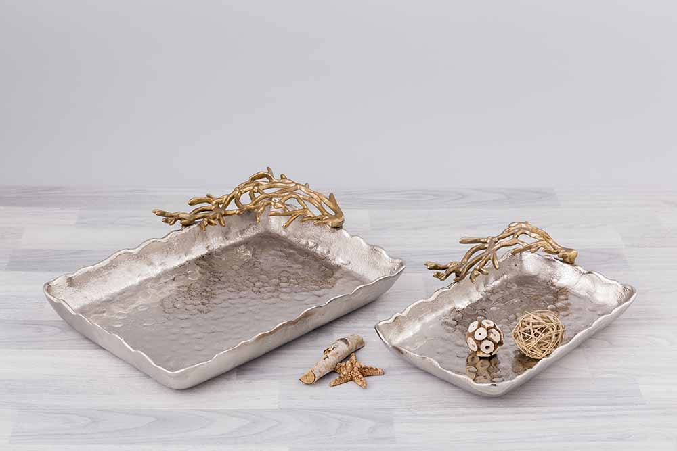
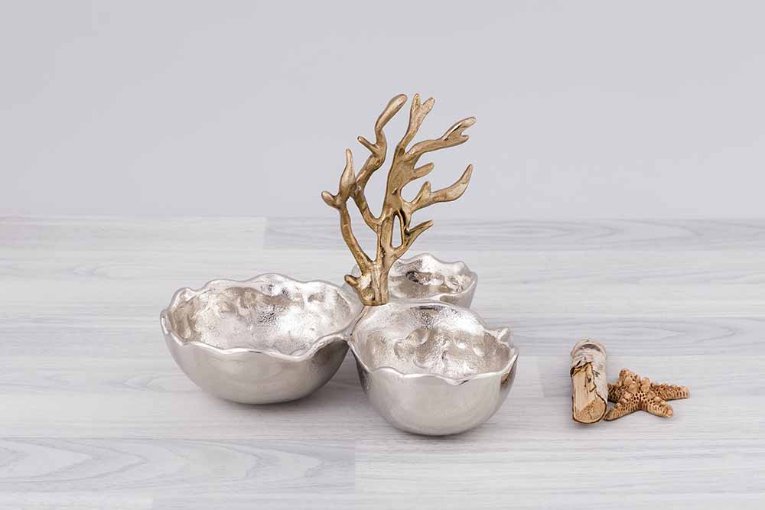
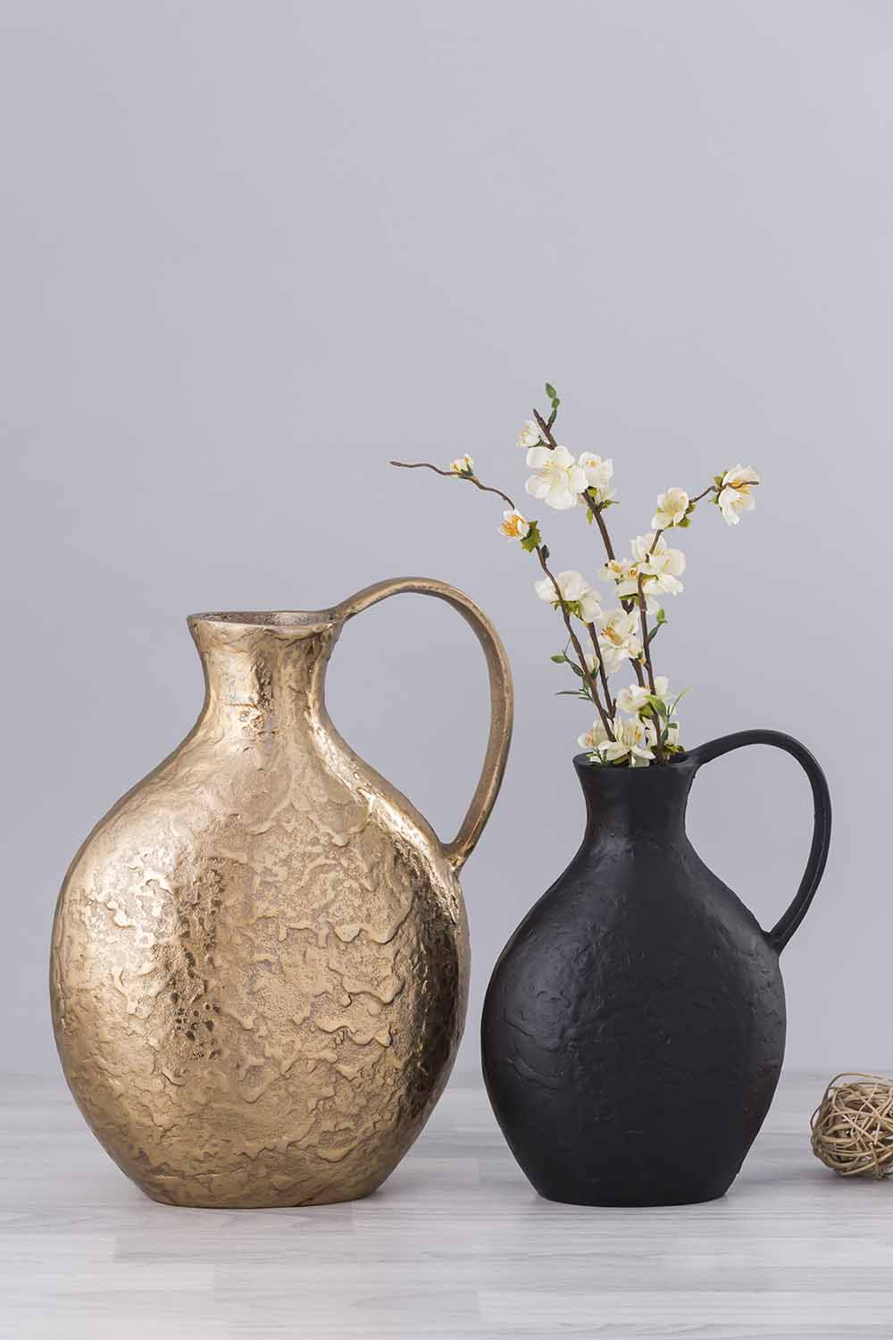
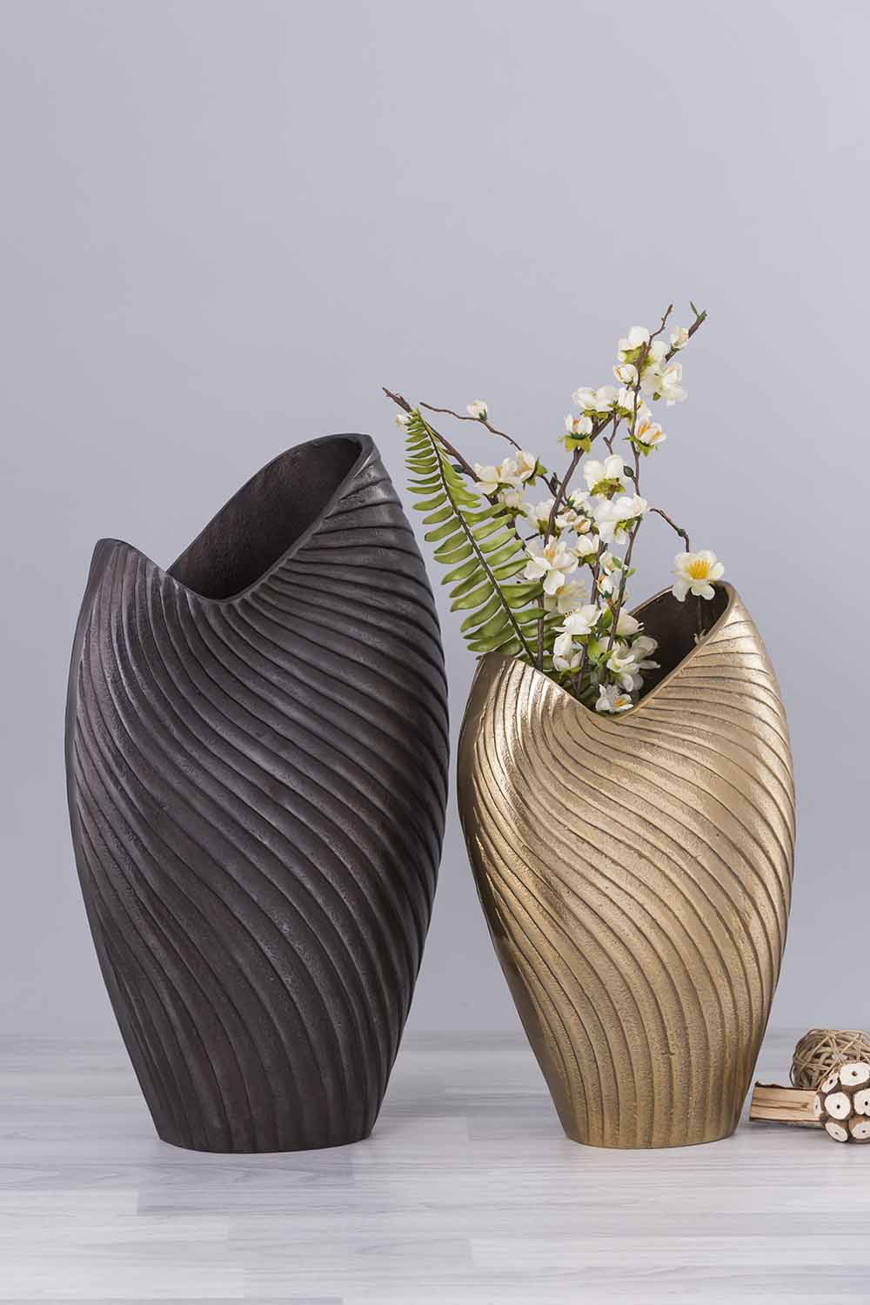
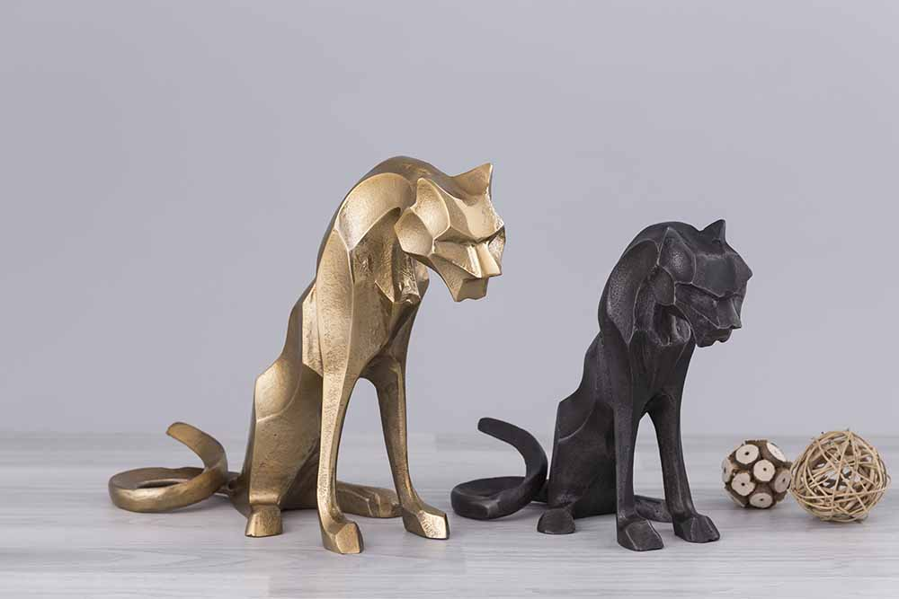
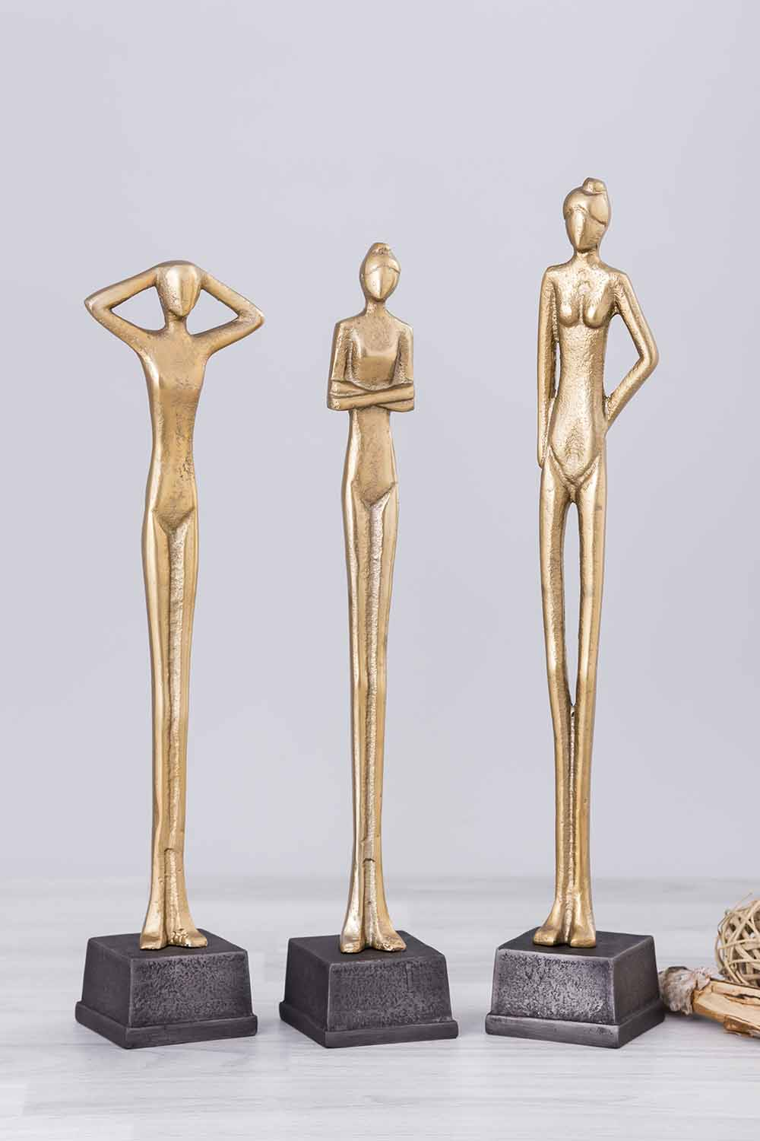
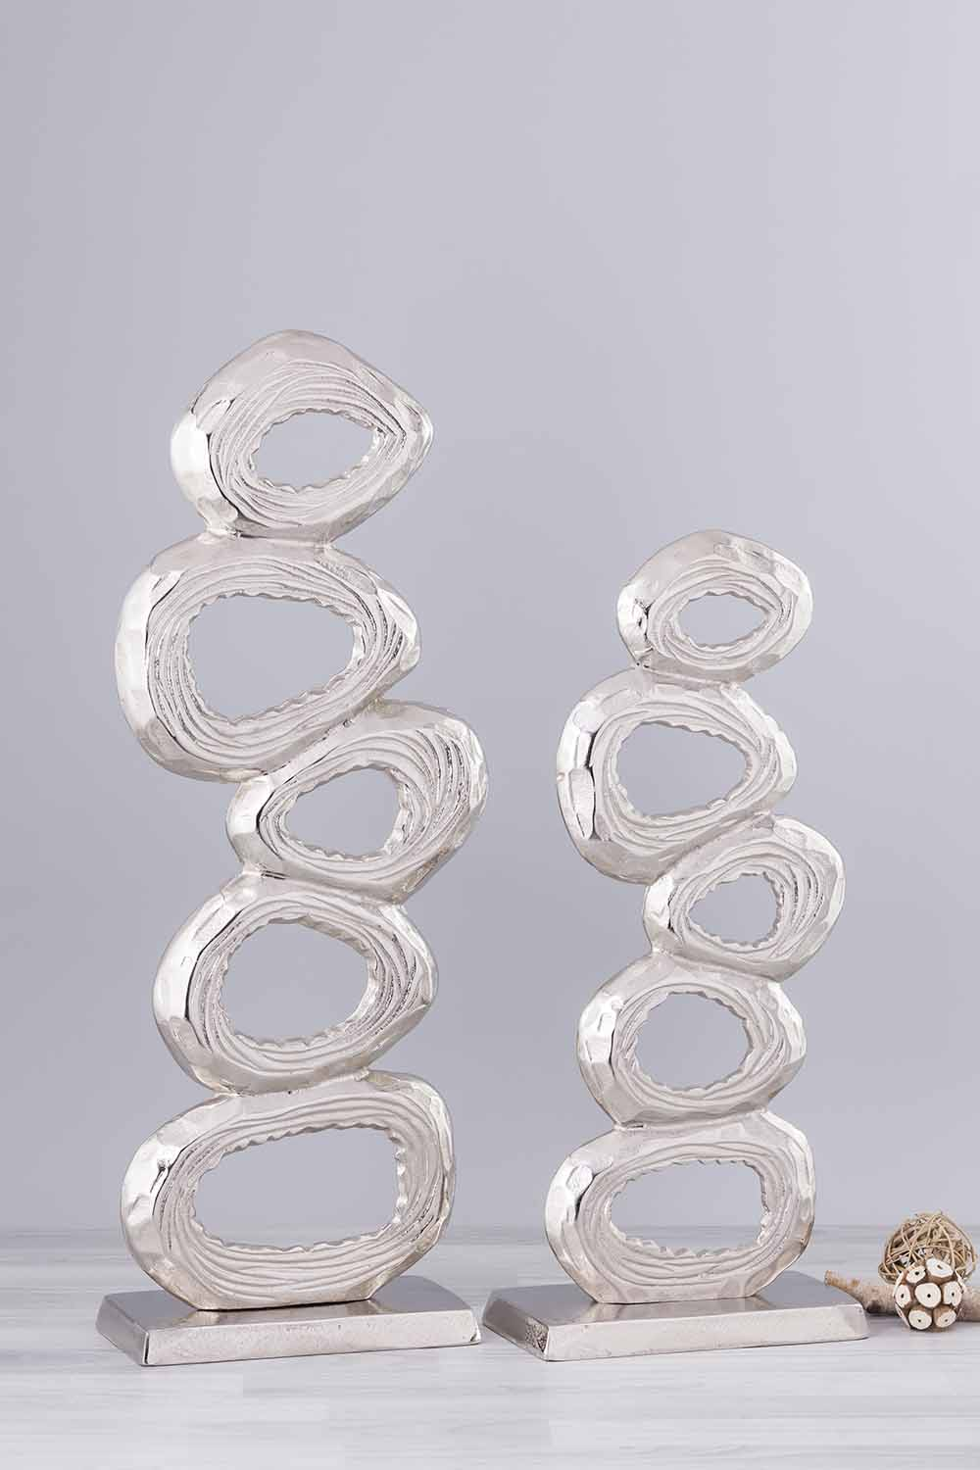
TABLE TOP ITEMS

Slide 14

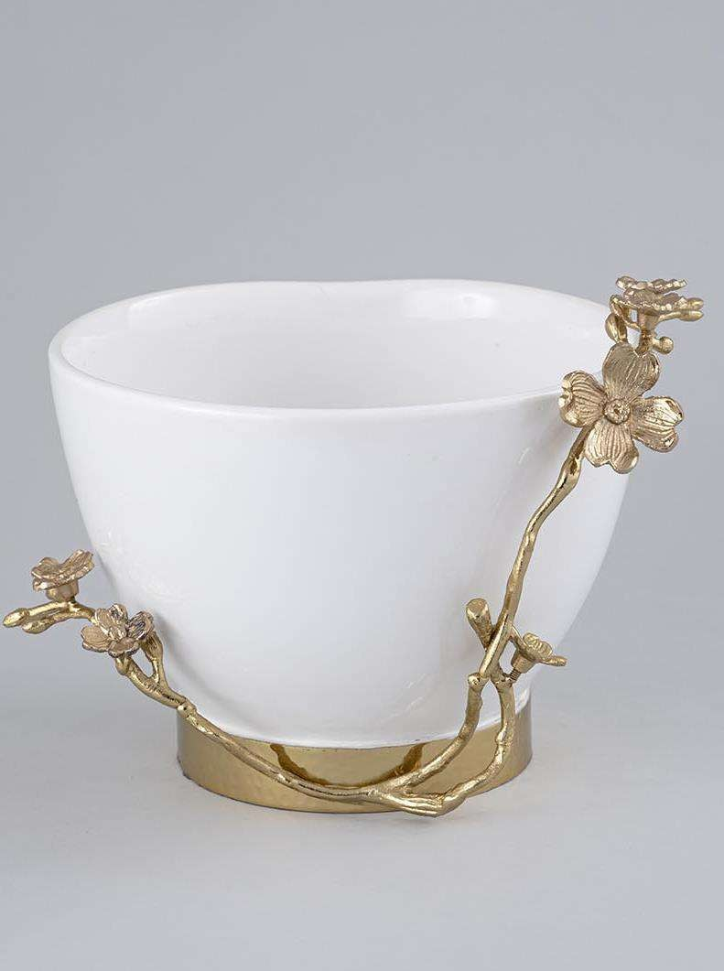
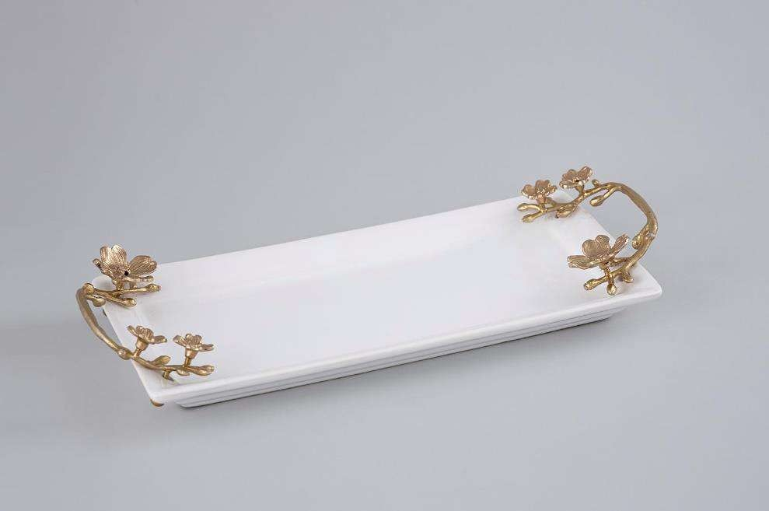
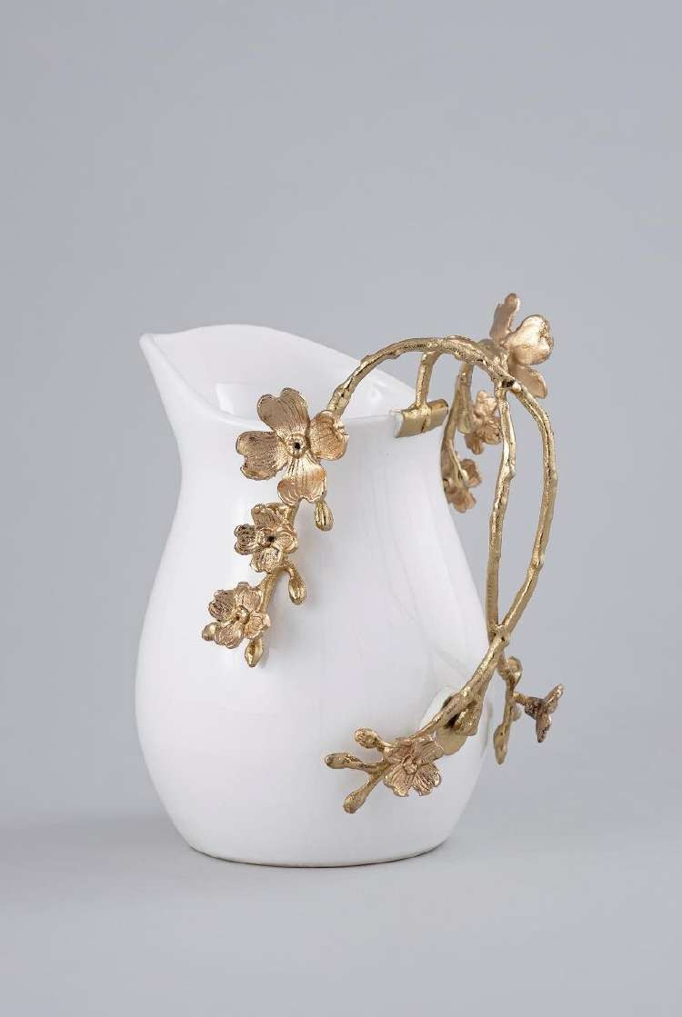
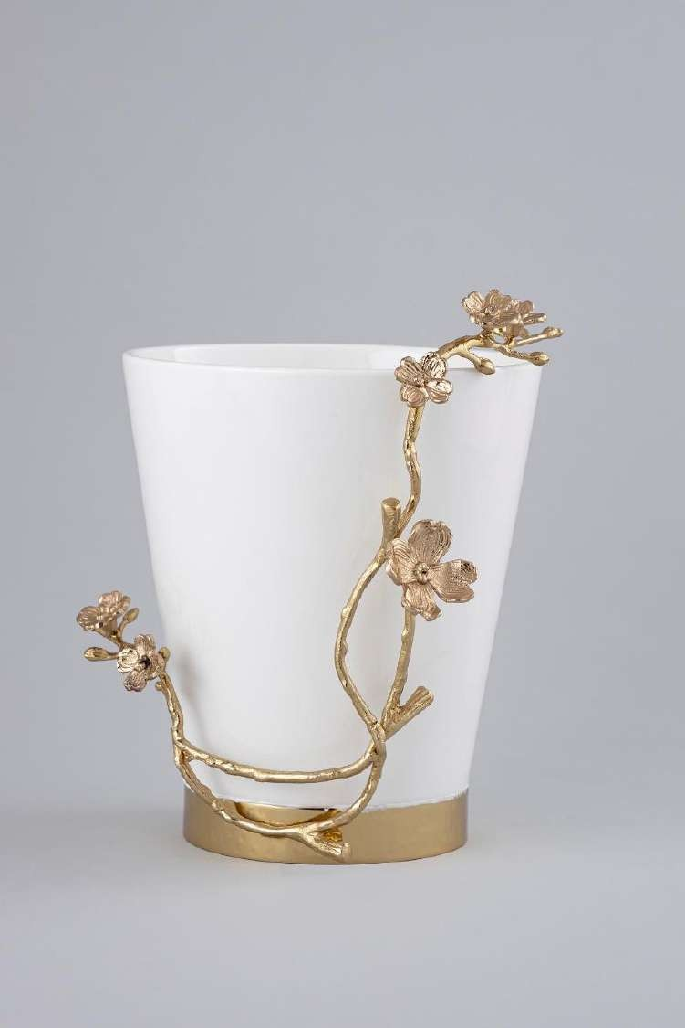
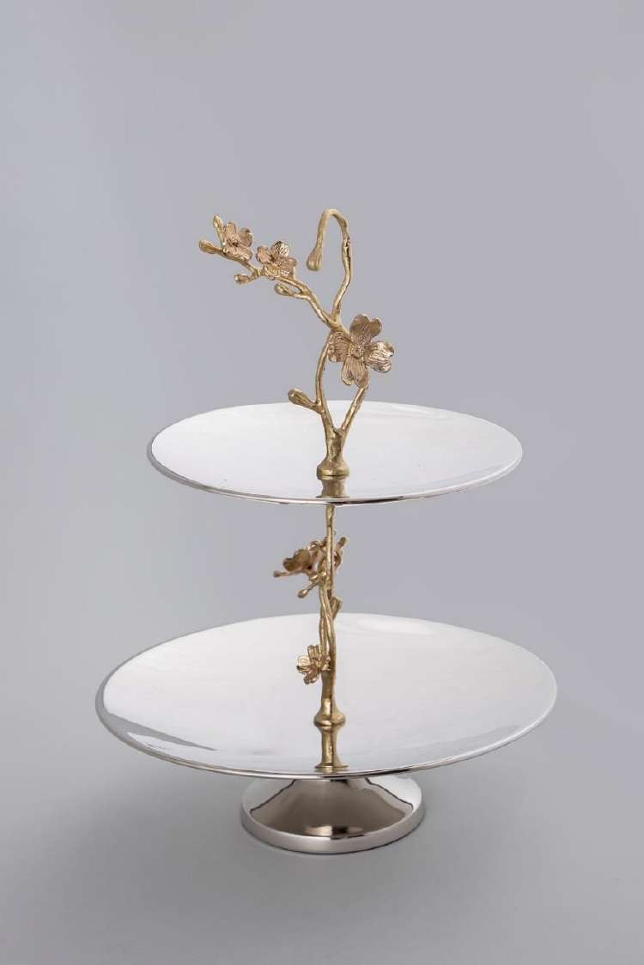
TABLE TOP ITEMS

Slide 15
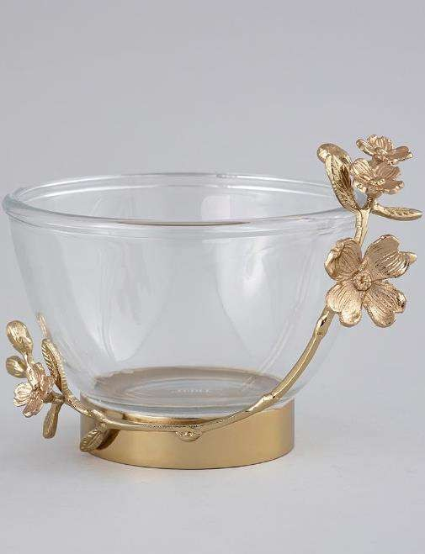
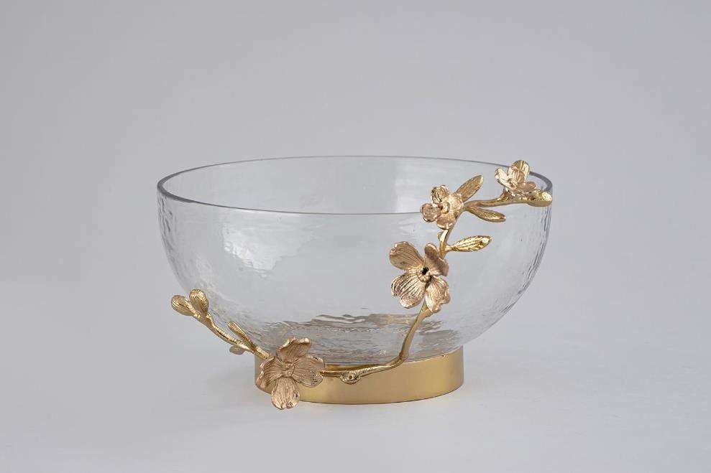



TABLE TOP ITEMS

Slide 16


TABLE TOP ITEMS

Slide 17


BAR ACCESSORIES

Slide 18





BAR ACCESSORIES

Slide 19


BAR ACCESSORIES

Slide 20



BAR ACCESSORIES

Slide 21



BAR ACCESSORIES

Slide 22




BAR ACCESSORIES

Slide 23










METAL VOTIVES
A1-1622
A1-4968
A1-1623
A1-2346
A1-3667
A1-1607
A1-2338
A1-1603
A1-1604
A1-4967

Slide 24




















ceramic

Slide 25


















ceramic

Slide 26













Wooden

Slide 27












Wooden

Slide 28












CUP & GLASS

Slide 29















BASKETRY

Slide 30














BASKETRY

Slide 31






















CUSHIONS & THROWS

Slide 32















CUSHIONS & DECOR

Slide 33















THROWS

Slide 34










PLACEMATS & RUNNERS

Slide 35















WALL DECOR

Slide 36












FURNITURE

Slide 37















FURNITURE

Slide 38













FURNITURE

Slide 39
FSTAINLESS STEEL FURNITURE AND OTHER ITEMS

Slide 40











BAR ACCESSORIES

Slide 41






LOOK BOARDS

Slide 42




LOOK BOARDS : BAR

Slide 43


LOOK BOARDS

Slide 44


LOOK BOARDS

Slide 45





NAPKIN RINGS
A1-279
A1-249
A1-280
A1-272
A1-287

Slide 46




















ANTIQUES N FIGURENES
AA-22020
AA-22034
AA-22035
AA-22036
AA-22037
AA-22038
AA-22046
AA-22047
AA-22039
AA-22040
AA-22041
AA-22042
AA-22043
AA-22044
AA-22048
AA-22049
AA-22050
AA-22051
AA-22052
AA-22053

